Slide 1
BAN 502 – Module 3 Logistic Regression Thresholds for Classification
Dr. Stephen E. Hill

Slide 2
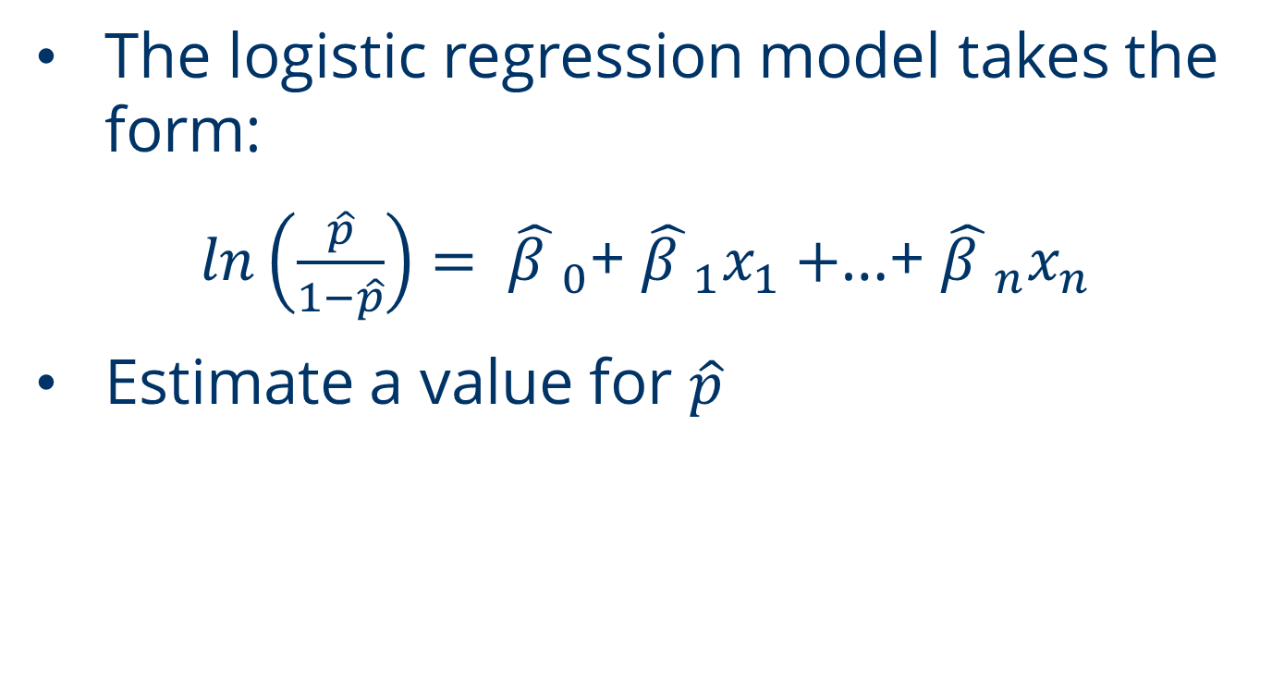
Logistic Regression
The logistic regression model takes the form:
$ln\left(\frac{\hat{p}}{1−\hat{p}}\right)= {\hat{β }}_{0}$+ ${\hat{β }}_{1}x_{1}+$…+ ${\hat{β }}_{n}x_{n}$
Estimate a value for $\hat{p}$

Slide 3
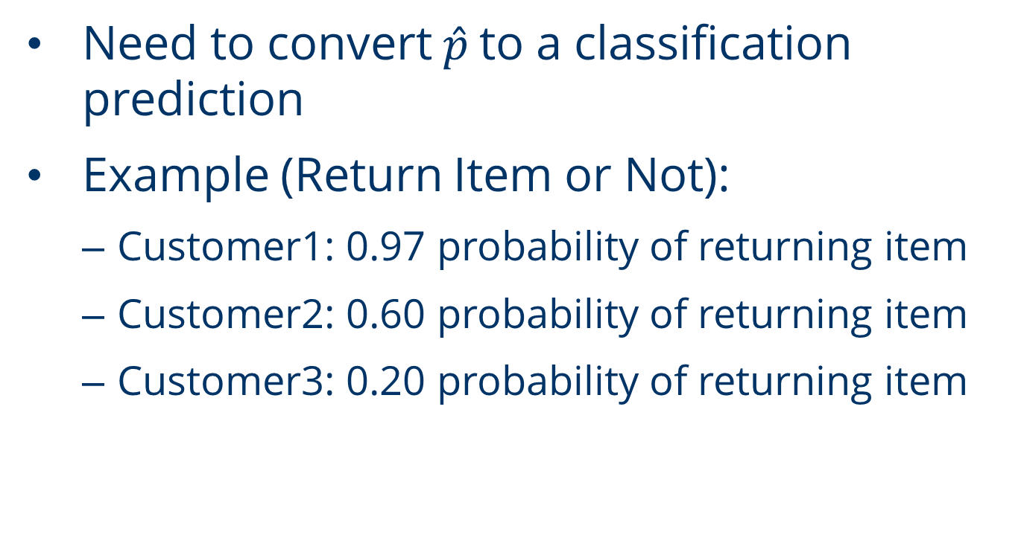
Predictions
Need to convert$\hat{p}$ to a classification prediction
Example (Return Item or Not):
Customer1: 0.97 probability of returning item
Customer2: 0.60 probability of returning item
Customer3: 0.20 probability of returning item

Slide 4
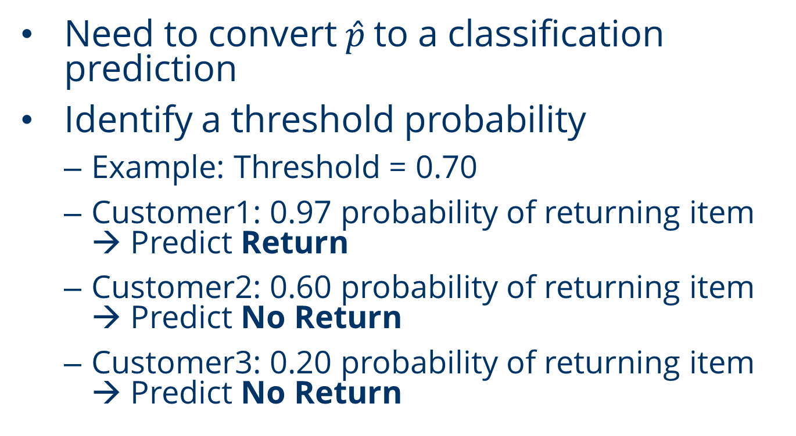
Predictions
Need to convert$\hat{p}$ to a classification prediction
Identify a threshold probability
Example: Threshold = 0.70
Customer1: 0.97 probability of returning item → Predict Return
Customer2: 0.60 probability of returning item → Predict No Return
Customer3: 0.20 probability of returning item → Predict No Return

Slide 5
Predictions
Threshold selection → Select to:
Maximize Accuracy
Balance Specificity & Sensitivity

Slide 6
Predictions
Balance Specificity & Sensitivity
1
1.0
0.5
TPR
(Sensitivity)
0.0
0
FPR
(1 - Specificity)
1

Slide 7
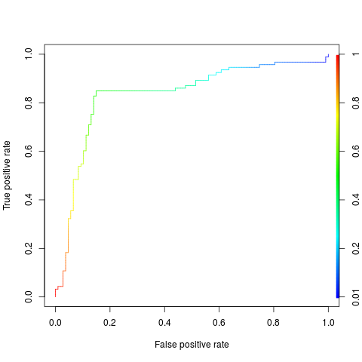
Logistic Regression
Logistic Regression Thresholds in software

